Slide 1
Single Layer Multiclass Perceptrons
Bhaskar Bandyopadhyay
Dushyant Sabharwal
Mahesh Kumar Saini

Slide 2
Perceptrons
Concept of a perceptron is very similar to the way neurons in the human brain operate
It is the simplest form of a neural network which can only classify linear functions
Performs pattern classification with only two classes

Slide 3
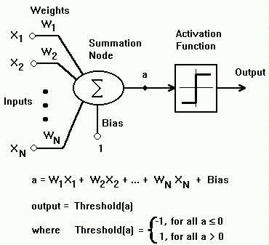
The Perceptron Model

Slide 4
The Perceptron Model
Inputs coming are multiplied with the weights of the input, the initial weights can be randomly initialized or all zero
Threshold is applied on the sum of dot product of weights and inputs, if the output is above the threshold then the perceptron fires
The output of the perceptron depends on the threshold/activation function used which can be a hard limit or a soft limit function

Slide 5
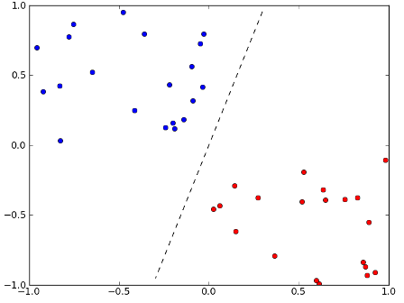
Perceptron As a Classifier

Slide 6
Perceptron As a Classifier
Perceptron can only be used to classify functions which are linear in nature as depicted by the above figure
Classification of points is done in the feature space so the linearity has to be in the feature space
Functions which depict a non linear behavior, perceptron is not the right choice there to be used

Slide 7
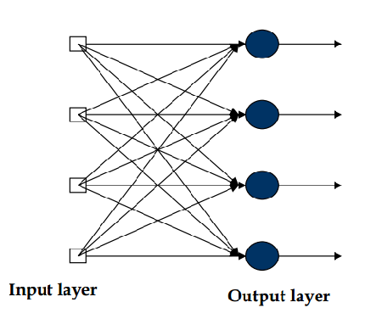
Single Layer Multi-Perceptron Classifier

Slide 8
Single Layer Multi-Perceptron Classifier
This kind of a network has a single layer containing multiple perceptrons
Each perceptron in the single layer can be perceived to be a representative of a particular class
Lets say we have 3 classes land, water and vegetation so when a test pixel is presented to the classifier only the perceptron corresponding to that class should fire
Perceptron for the land class will act as a linear classifier in a sense as differentiating between land and non-land pixel

Slide 9

Weight Updation
The weight updation depends on the threshold function which has been used i.e. whether a hard limit threshold or a soft limit threshold is used
The general idea is to move the weight vectors to a space where the classification is between two classes is accurate
Delta w is the change in weight, n is the learning rate, t is the desired output, y is the actual output and x is the input pattern

Slide 10
Network Architecture
The no. of classes to be taken is taken as input from the user
Equal to the no. of classes we have perceptrons in the single layer of the network
Weight updation is directly proportional to the amount of deviation from the desired output

Slide 11
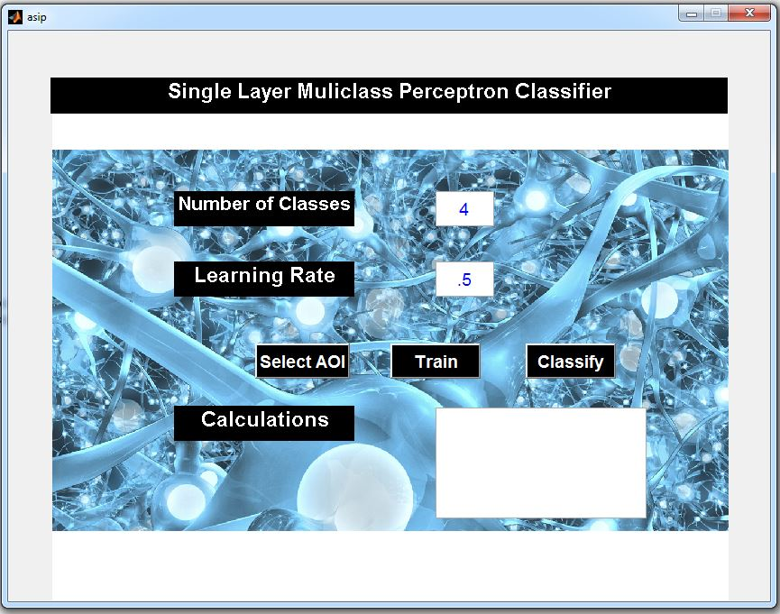
Input From the User

Slide 12
Input From the User
User can select the training pixels using the Region of Interest Tool
He can select that many ROIs equal to the no. of classes
Training is performed on the input pixel vectors given by the user
The no. of training epochs depend on the time it takes for the perceptron algorithm to converge

Slide 13
References
Raudys, Šarūnas. "Evolution and generalization of a single neuron: I. single-layer perceptron as seven statistical classifiers." Neural Networks 11, no. 2 (1998): 283-296.
Discriminant Classifiers Lectures Slides for GNR 607
http://undergraduate.csse.uwa.edu.au/units/CITS4210/lectureNotes/Lect4-UWA.pdf

